Slide 1

FACULTY OF COMPUTER APPLICATIONS (MCA)
2022-2023
A Presentation on
“FAKE CURRENCY DETECTION USING MACHINE LEARNING”
Submitted By :
Abishek Datta Jagtap
(SG21MCA002)
Under the Guidance of:
Dr. Shrikant M Patil

Slide 2
FAKE CURRENCY DETECTION USING MACHINE LEARNING

Slide 3
Content
Introduction
Problem statement
Objectives
Hardware and Software Requirements
Project Architecture
Modules
Algorithms
Flow Chart
Use Case Diagram
Sequence Diagram
Validation
Conclusion

Slide 4
Introduction
In our fast-paced financial world, banknotes play a critical role as a valuable asset of our country.
However, counterfeit notes are being introduced into the market, closely resembling genuine ones, causing financial discrepancies.
Human detection of forged bank currency is difficult due to the high precision with which fraudsters create fake notes.
Government-designed features on banknotes help identify genuine ones, but counterfeiters mimic these features with great accuracy.
To combat this problem, an automated system using machine learning can be implemented in banks and ATMs.
The goal is to design an automated system to determine the legitimacy of banknotes.
By inputting the physical features of the banknote and applying various machine learning techniques, relevant features are extracted.
These features are then fed into SML algorithms to predict whether the note is genuine or fake.

Slide 5
Problem Statement
Developing an automated system using machine learning to detect counterfeit banknotes from genuine ones, addressing the rising concern of fake currency in the financial market.

Slide 6
Objectives
To build the model with maximum accuracy using the appropriate Machine learning algorithms.
To save the final built model.
Design web pages using HTML and CSS.
Expose the web pages using Django framework.

Slide 7
Hardware and Software Requirements
SOFTWARE REQUIREMENT
Operating system : Windows, Linux.
Technology : Python 3.0 version, Visual Studio.
Framework : Django 3.0 or above.
Additional Tools and Libraries : numpy, pandas, matplotlib, scikit-learn, seaborn, ipython, ipython-genutils, PyMySQL, Django, lightgbm.
3.2 HARDWARE REQUIREMENT
Processor : Intel i3 or above.
RAM : 4GB or more.
Hard disk : 250GB or more.

Slide 8
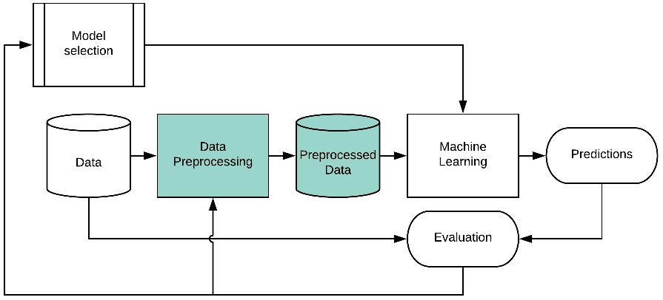
Project Architecture

Slide 9
Modules
Login
Allows users to authenticate and access the system securely.
Provides user-specific access to the functionalities of the application.
Upload Dataset
Enables users to upload datasets from local storage or external sources.
Validates the format and size of the uploaded data before processing.
Preprocess Dataset
Performs data cleaning, normalization, and transformation on the uploaded dataset.
Handles missing values and prepares the data for training machine learning models.

Slide 10
Train ML Algorithms
Trains machine learning algorithms using the preprocessed dataset.
Evaluates and selects the best-performing algorithm for Fake Currency Detection.
Fake Currency Detection:
Utilizes the trained ML model to detect fake currency from given input data.
Generates prediction results and provides insights on currency authenticity.
Logout:
Allows users to securely log out from the system and terminate their session.
Ensures the protection of user data and privacy.

Slide 11
System Design
Data Flow Diagram (DFD)
Start
Login
Upload Dataset
Preprocess Dataset
Train ML Algorithms
Evaluate Models
Logout
Display Result
Fake Currency Detection
Select Best Model
End

Slide 12
Use Case Diagram
Data Collection
Data Preprocessing
Feature Extraction
Build Model
Comparison Graph
Load Model
Sign up & Sign In
Upload Test Data
Predict Genuine or Fake result

Slide 13
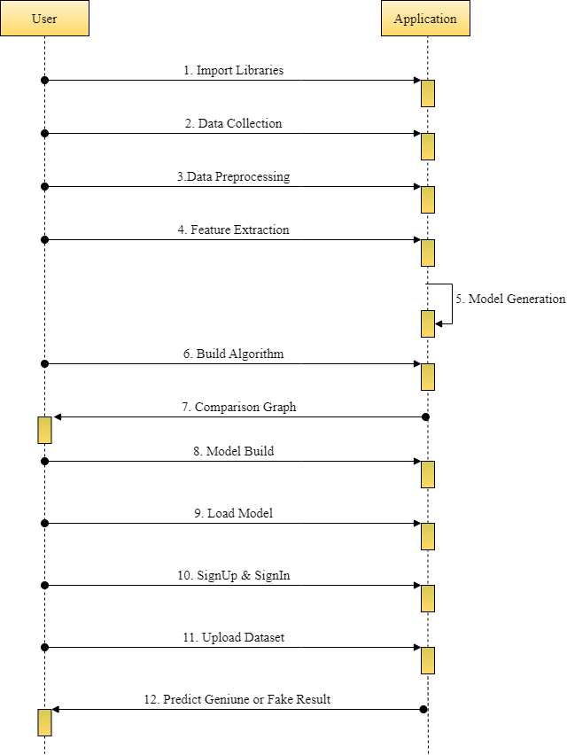
Sequence Diagram

Slide 14
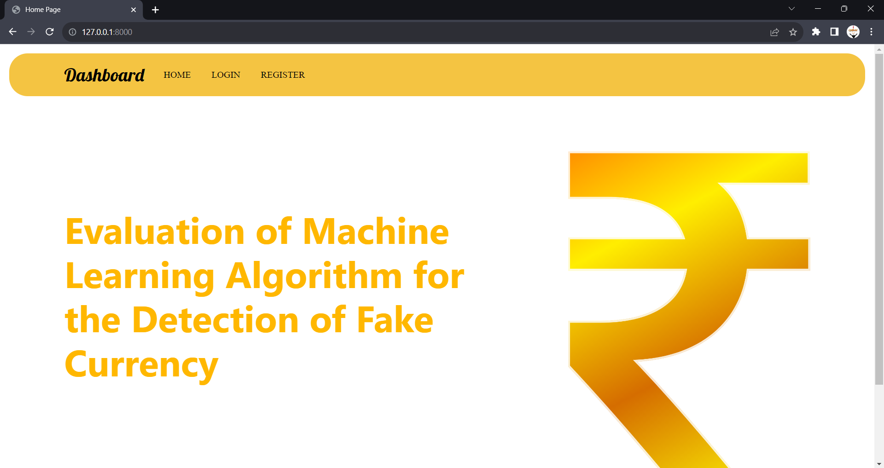
Form Design
HOME

Slide 15
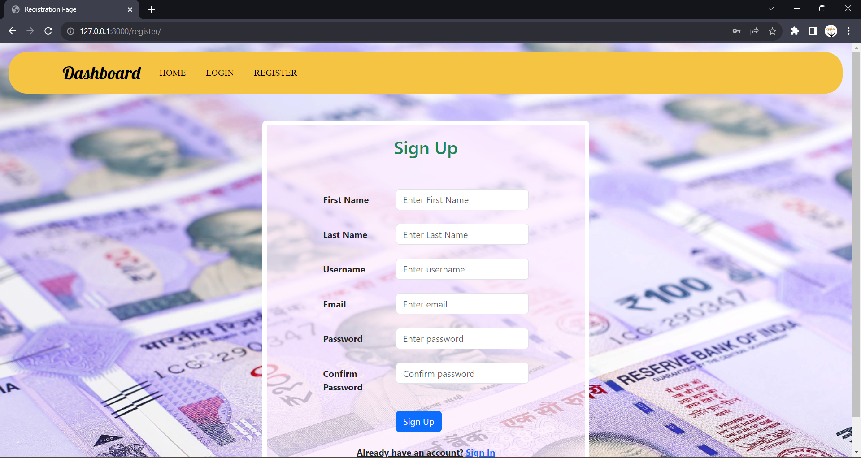
Registration Page

Slide 16
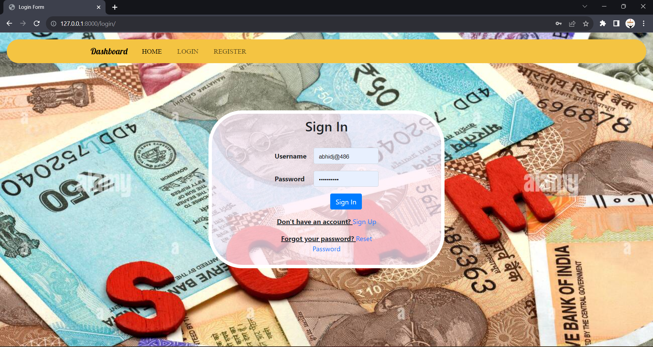
Login Page

Slide 17

User Home Page

Slide 18
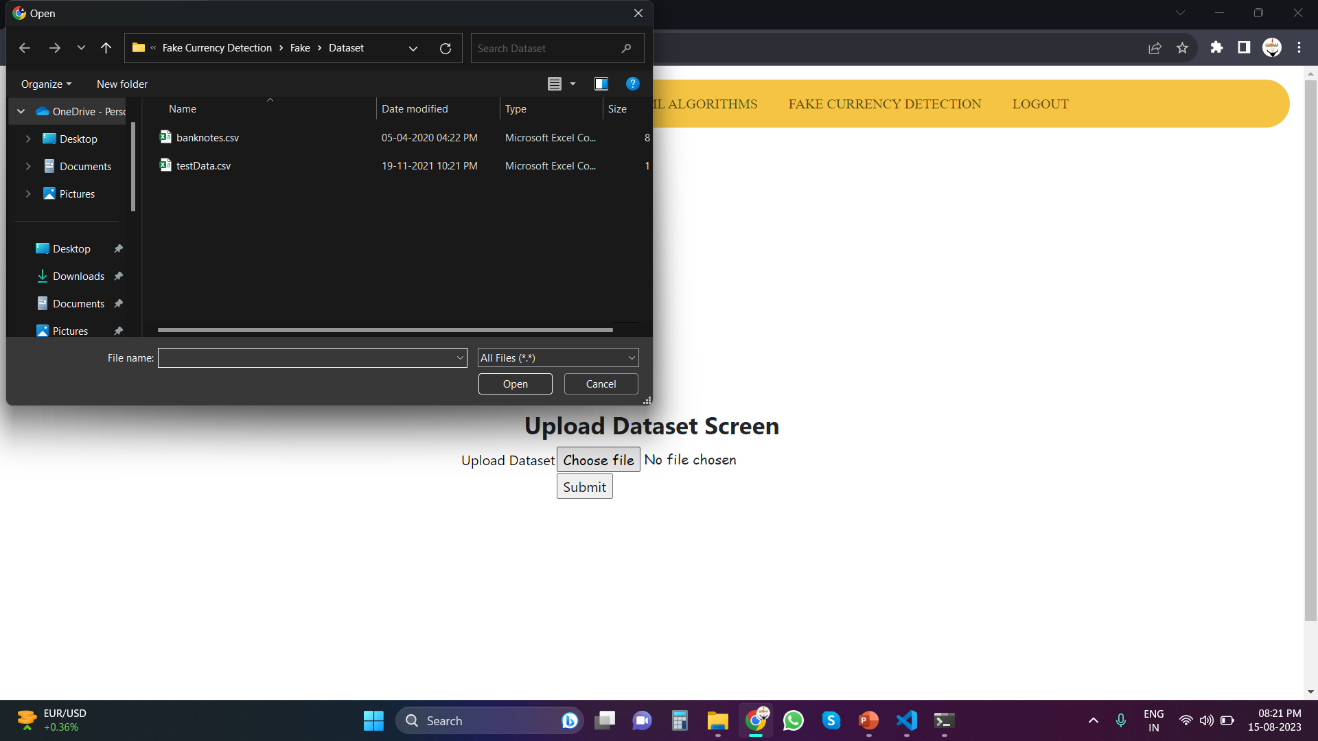
Upload Dataset

Slide 19
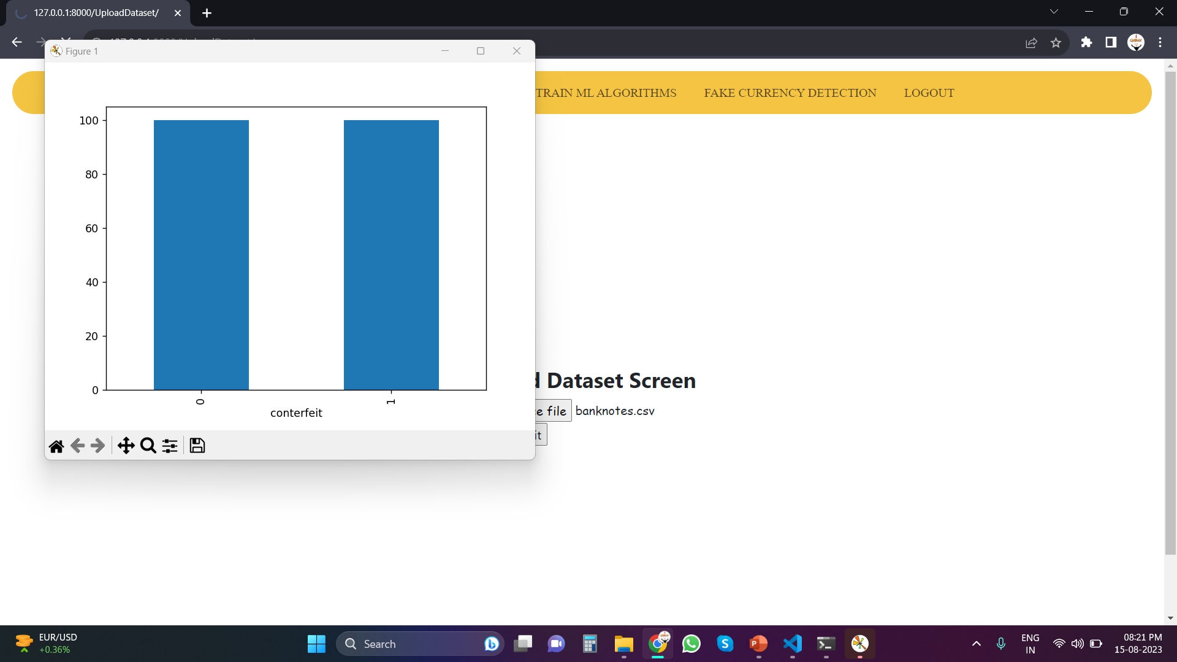
Classification

Slide 20
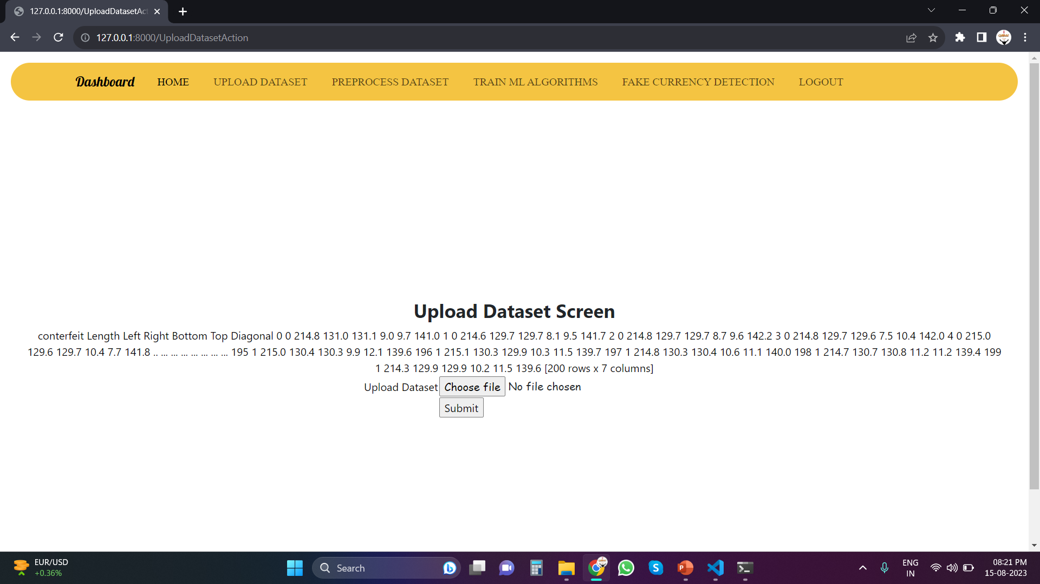
Extracted Features

Slide 21
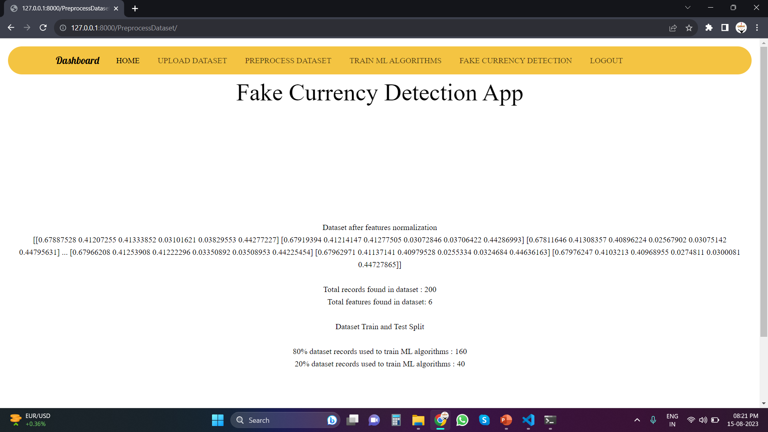
Pre-Process Dataset

Slide 22
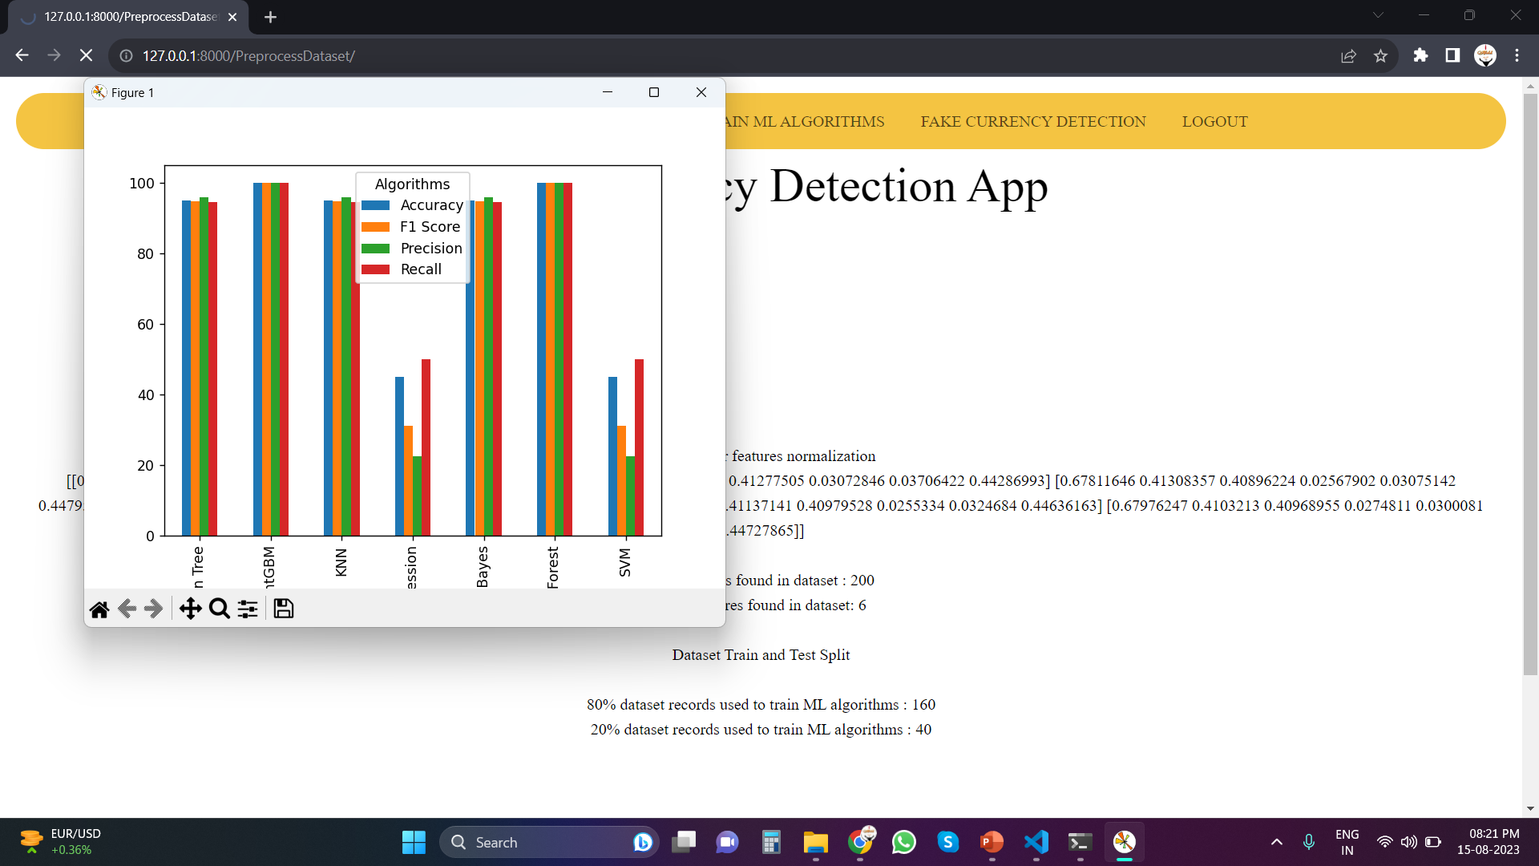
Algorithm’s Evaluation

Slide 23
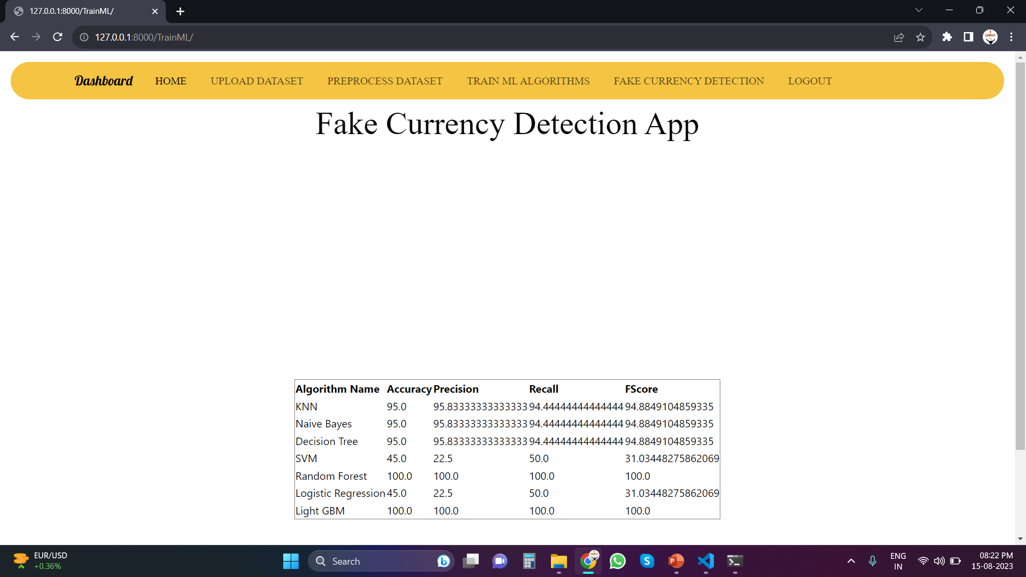
Algorithm’s Performance

Slide 24
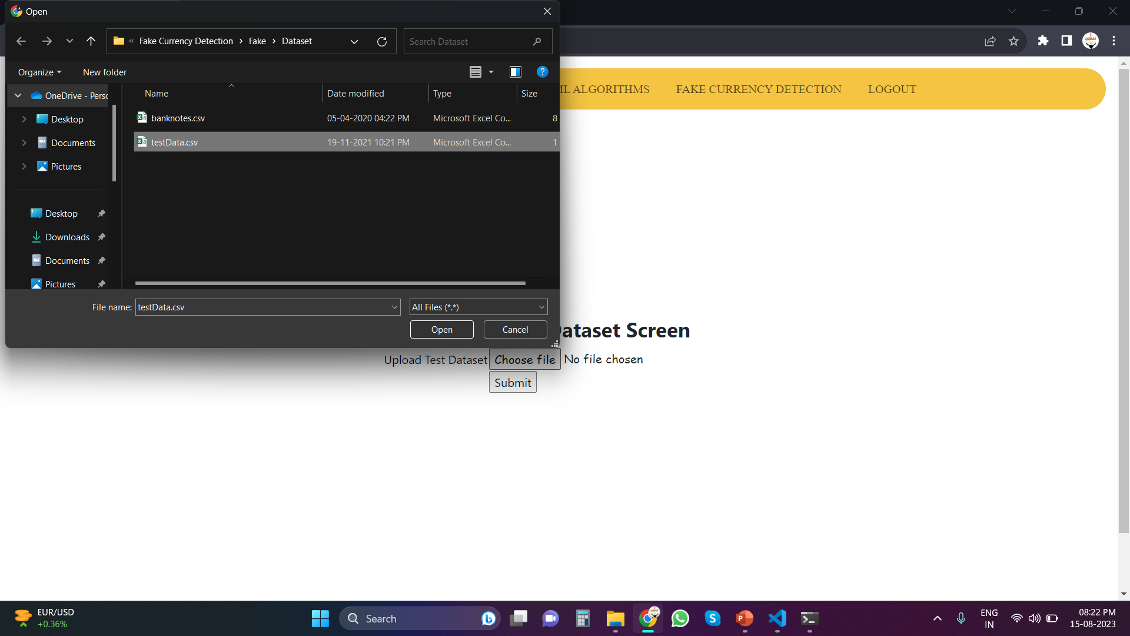
Upload Test Data

Slide 25
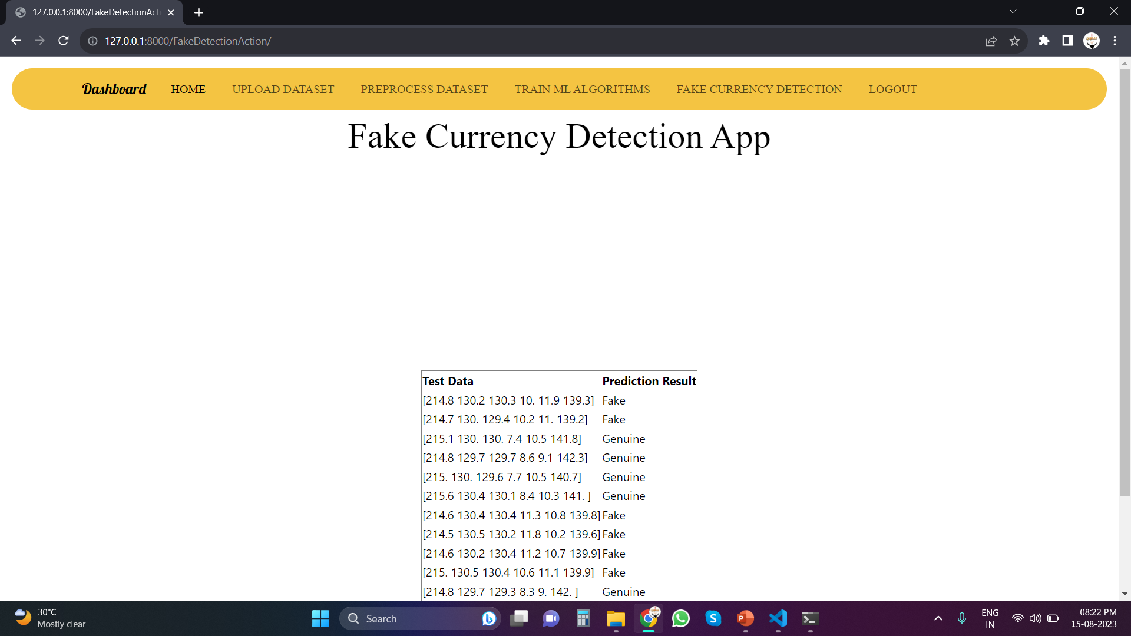
Final Prediction

Slide 26
Conclusion
In this study, I 'have conducted a comprehensive analysis of various machine learning algorithms applied to the banknote authentication dataset sourced from the UCI Machine Learning repository.
I 'have evaluated the performance of six popular algorithms, namely Support Vector Machine (SVM), Logistic Regression (LR), Naive Bayes (NB), Decision Tree (DT), Random Forest (RF), and k-Nearest Neighbors (KNN).
As an extension to this analysis, I 'have also introduced the LIGHTGBM algorithm, a gradient boosting framework, to further enhance prediction accuracy.
In Conclusion, these findings emphasize the importance of algorithm selection and parameter tuning in achieving optimal predictive performance.

Slide 27
Thank You

